Slide 1
Welcome to Sugar Rush!
This is a game which tracks the sugar consumption of a hobbit. The purpose of this game is to help you understand the amount of sugar in everyday foods and encourage healthier eating patterns.
Login
Play as Guest

Slide 2
Login
Email
Password
Login
Register
Cancel

Slide 3
Registration
Username
Email
Password Label
Confirm Password
Submit
Cancel

Slide 4

Welcome to Hobbit Village
Logout
?
1
🔒
🔒
🔒
🔒
🔒

Slide 5
<Help Text>
Help
<Village Text>
?
Instructions
Select a hobbit home to meet a new hobbit
Help the hobbit pick out meals to eat throughout the day
Try to select meals that are low in sugar to avoid a sugar crash!
When you have successfully helped your hobbit, try to help some of their neighbors!
<House>
<House>
<House>
<House>
🔒
Close

Slide 6
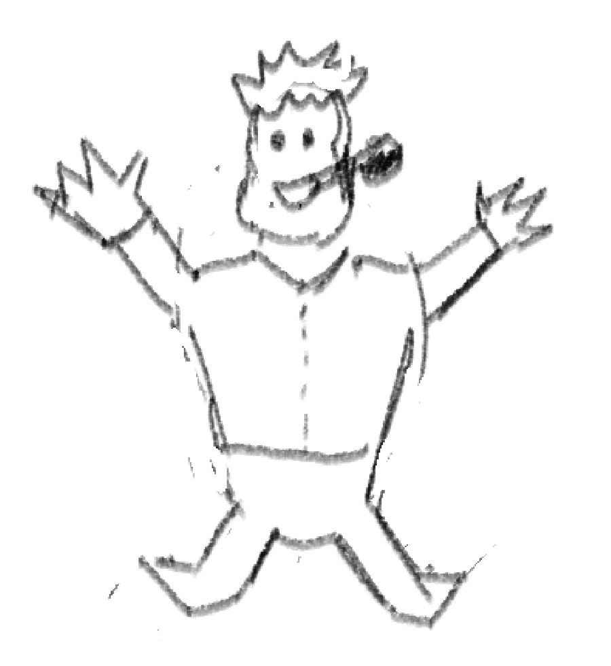


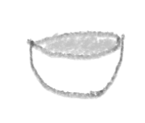
First meal of the day!
Breakfast
Apple
Croissant
Cocoa Pops
Current Sugar Level:
Quit
?

Slide 7
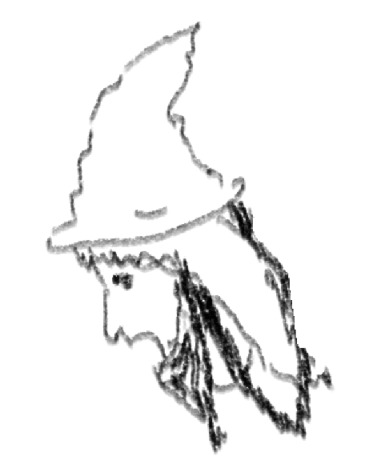

Not bad, halfling!
First meal of the day!
Breakfast
Apple
Croissant
Cocoa Pops
Current Sugar Level:
Quit
?

Slide 8
Fool of a Took!
First meal of the day!
Breakfast
Apple
Croissant
Cocoa Pops
Current Sugar Level:
Quit
?

Slide 9
Fool of a Took!
First meal of the day!
Breakfast
Apple
Croissant
Cocoa Pops
Current Sugar Level:
Quit
?

Slide 10
<Help Text>
Help
First meal of the day!
<Breakfast Title>
Choose the meal which you think has the lowest sugar level!
<Food Image 1>
<Food Image 2>
<Food Image 3>
<Food Title 1>
<Food Title 2>
<Food Title 3>
Close
<Sugar Cube Images>
Quit
?

Slide 11
Game Over!
Your Score:
Game Summary
Meal Summary
Home
Share Results
?

Slide 12


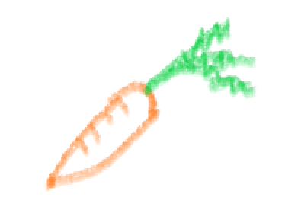
<Hobbit Image>
<Game End Title>
Breakfast
Second Breakfast
Elevenses
Luncheon
<Score Text>
Afternoon Tea
Dinner
Supper
<Nutritional Information>
<Nutritional Information>
<Nutritional Information>
<Game Summary Text>
<Nutritional Information>
<Nutritional Information>
<Nutritional Information>
<Nutritional Information>
<Meal Summary Button>
<Home Button>
<Share Results Button>
?
Close

Slide 13



<Hobbit Image>
Share
<Game End Title>
Share your results with family and friends!
<Score Text>
<Game Summary Text>
<Meal Summary Button>
Cancel
<Home Button>
<Share Results Button>

Slide 14
<Help Text>
<Hobbit Image>
Help
<Game End Title>
Share your results with friends and family, or return home and unlock another hobbit!
<Score Text>
<Game Summary Text>
<Meal Summary Button>
<Home Button>
<Share Results Button>
Close

